Slide 1
Sara Williford, M.D., Shuntai Zhou, M.D., Christina Burch, Ph.D., Ernest Asante-Appiah, Ph.D., Anita Howe, Ph.D., Ronald Swanstrom, Ph.D., Stanley M. Lemon, M.D. University of North Carolina at Chapel Hill Merck Research Laboratories

Slide 2
Hepatitis C resistance

Slide 3
Elbasvir Phase 1b Clinical Trial

Slide 4
HCV genome

Slide 5
Primer ID sequencing

Slide 6
Primer ID sequencing

Slide 7
RAV time course – placebo controls

Slide 8
RAV time course – Elbasvir monotherapy

Slide 9
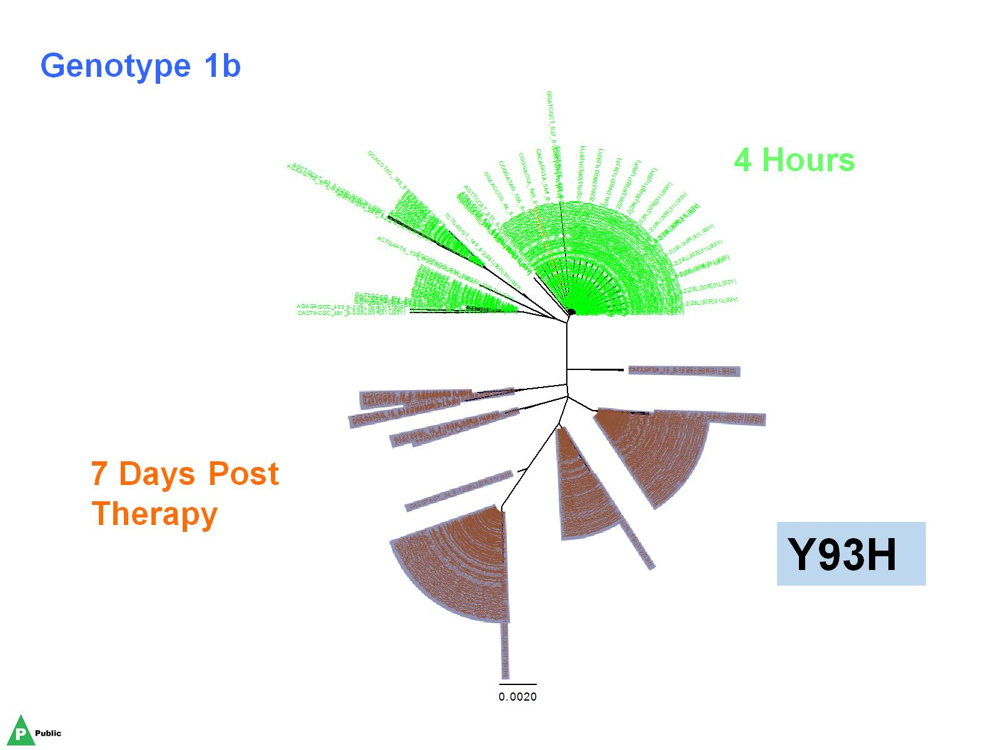

Slide 10
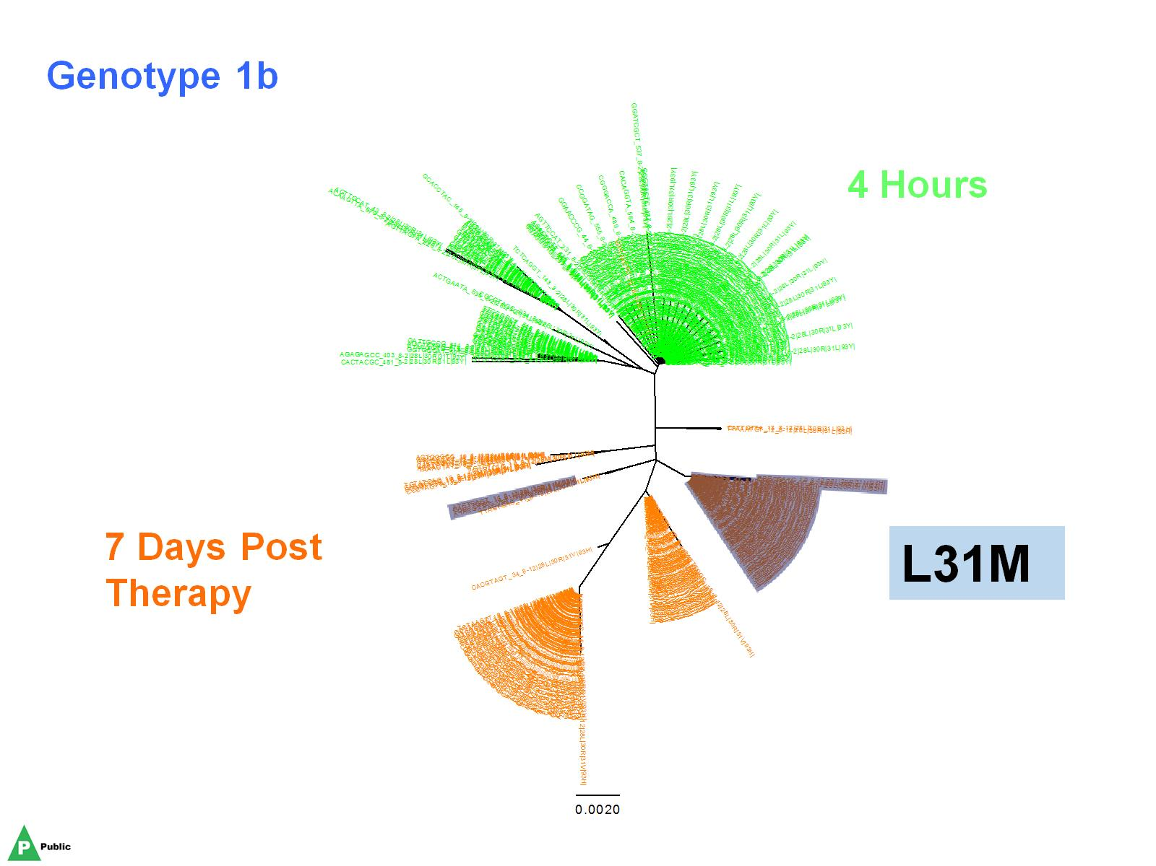

Slide 11
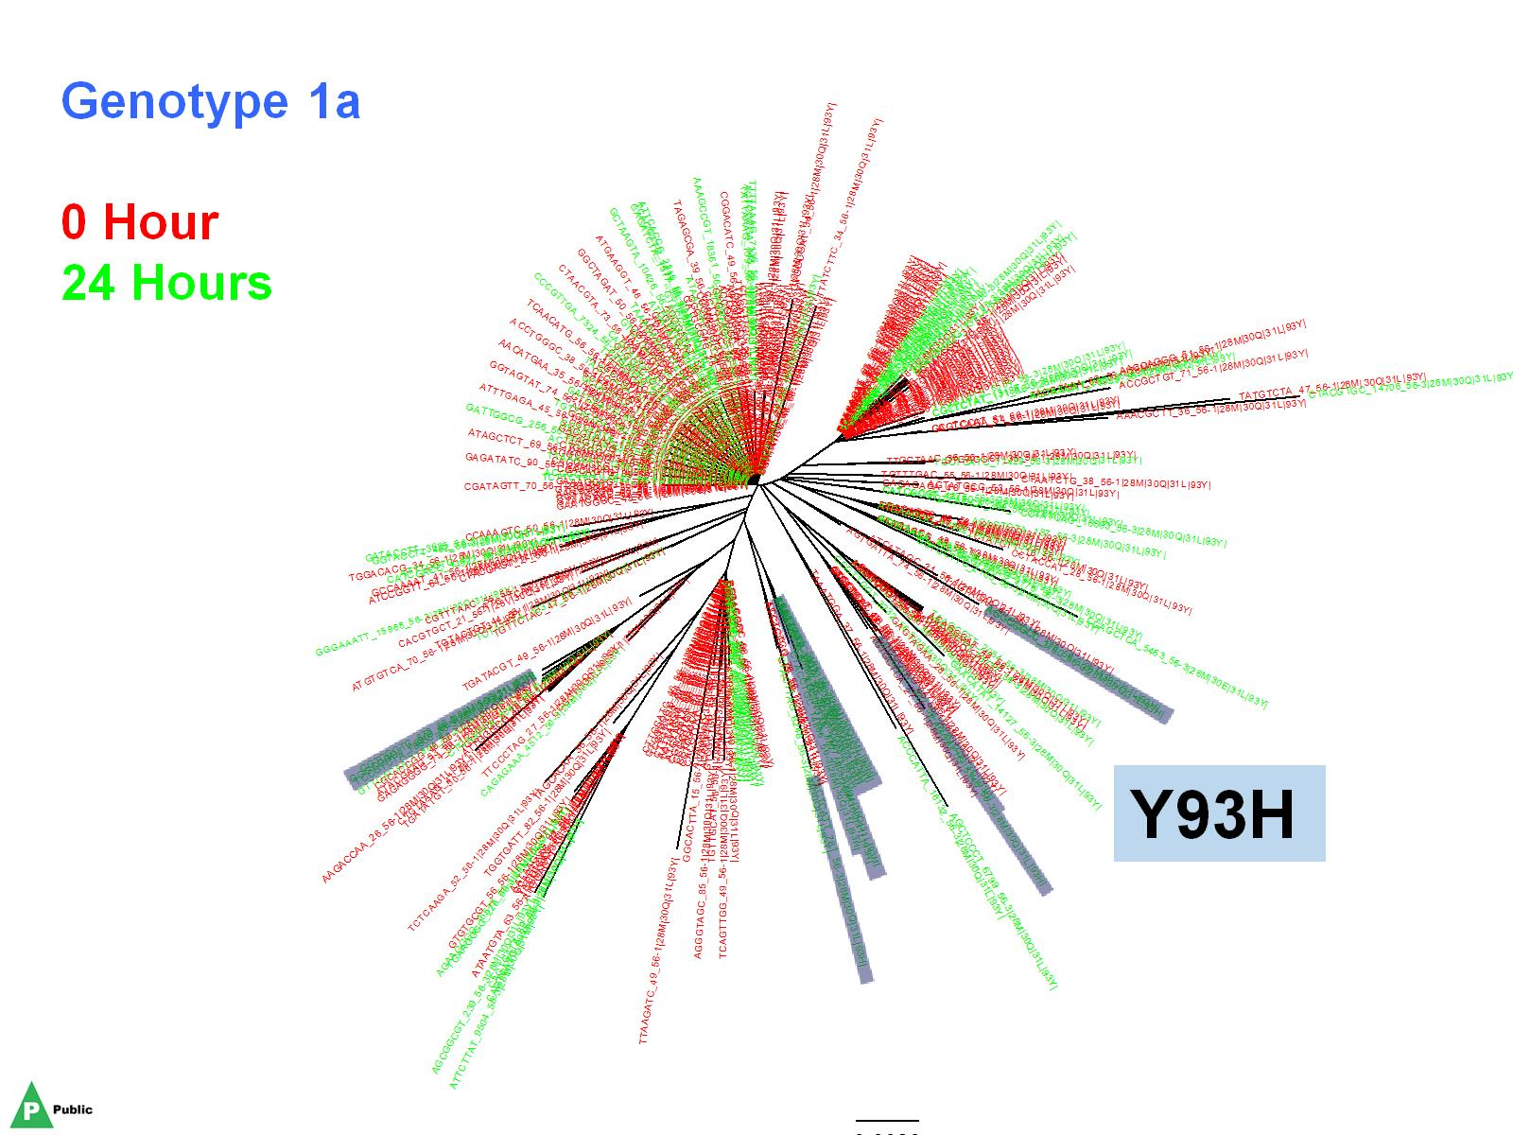

Slide 15
In vitro fitness of NS5A resistant variants

Slide 16
Q30R and L31M are mutually compensatory

Slide 17
Conclusions

Slide 18
Acknowledgements

