Slide 1
REAL-WORLD SAFETY, EFFECTIVENESS, AND PATIENT-REPORTED OUTCOMES IN PATIENTS WITH CHRONIC HEPATITIS C VIRUS INFECTION TREATED WITH GLECAPREVIR/PIBRENTASVIR: DATA FROM THE GERMAN HEPATITIS C-REGISTRY

Slide 2
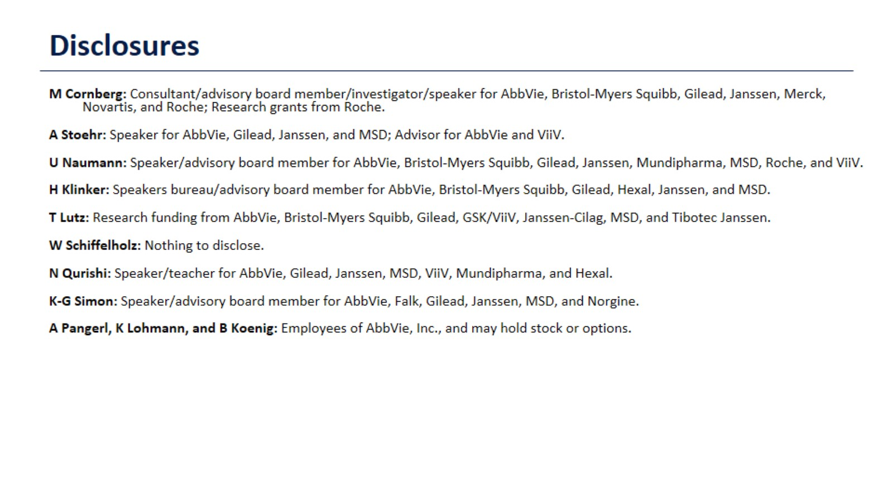
Disclosures

Slide 3
Disclosures

Slide 4
German Hepatitis C-Registry (DHC‐R)

Slide 5
Background and Objective

Slide 6
Study Population Receiving On-Label Glecaprevir/Pibrentasvir

Slide 7
Demographics and Clinical Characteristics at Baseline

Slide 8
Demographics and Clinical Characteristics at Baseline

Slide 9
SVR12 Rates in the Effectiveness Population

Slide 10
SVR12 Rates in the Effectiveness Population

Slide 11
SVR12 Rates in HCV Treatment-Naïve Non-Cirrhotic Patients

Slide 12
SF-36 Component Summary Scores at Baseline

Slide 13
SF-36 Physical Component Summary Score

Slide 14
SF-36 Mental Component Summary Score

Slide 15
Safety

Slide 16
Summary

