Slide 1
Efficacy and Safety of Glecaprevir/Pibrentasvir for 8 or 12 Weeks in Treatment-naïve Patients with Chronic HCV Genotype 3: An Integrated Phase 2/3 Analysis

Slide 14
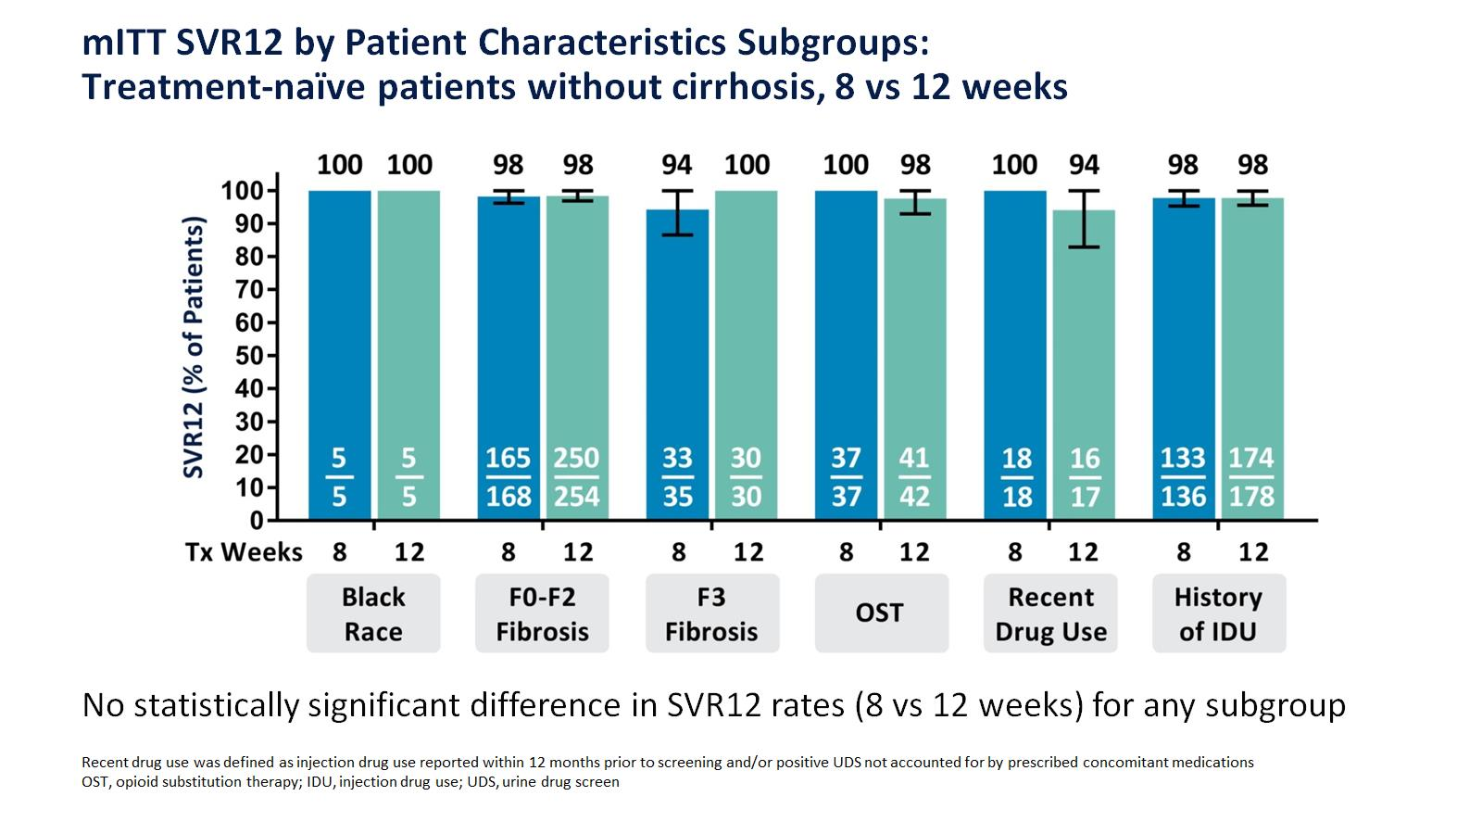

Slide 15
